Slide 1

Fortifying Cybersecurity
The Power and Potential of Multi-Factor Authentication (MFA)

Slide 2
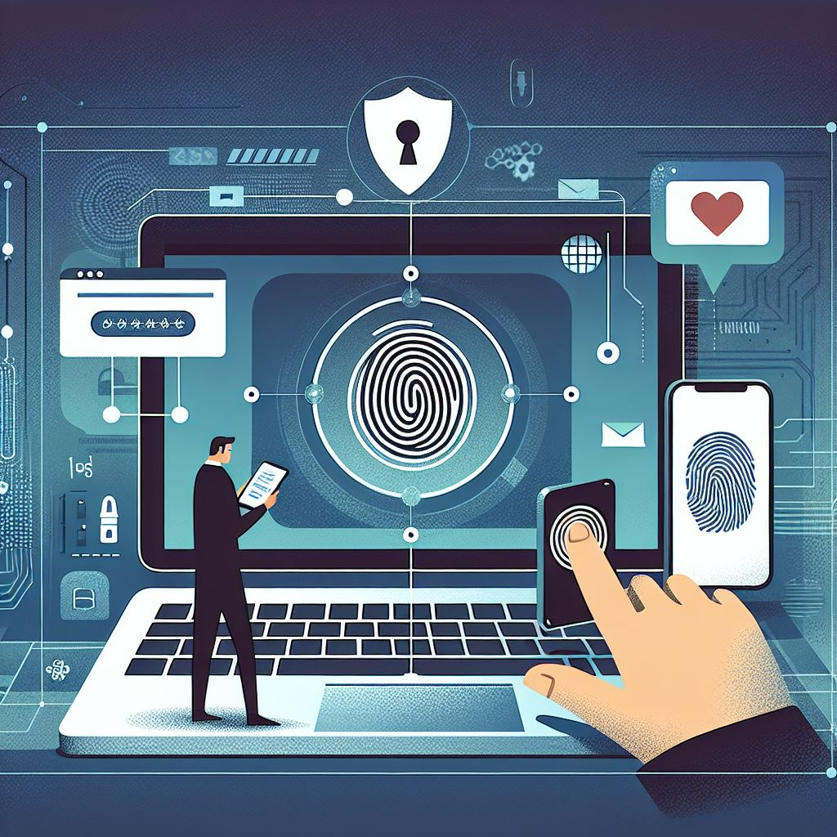
Introduction to Multi-Factor Authentication (MFA)
What is MFA? MFA (Multi-Factor Authentication) is a security process that requires users to provide multiple forms of verification before granting access to systems or information.
Why MFA Matters in Cybersecurity Traditional single-factor authentication, like passwords, is no longer enough.
MFA adds layers of protection, reducing the risk of unauthorized access.

Slide 3
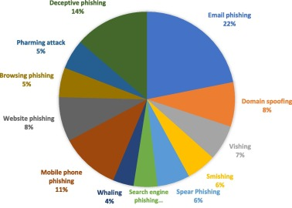
The Growing Threat Landscape
Rising Cyber Threats:
Cyberattacks are increasing in frequency and sophistication,
targeting individuals and organizations alike.
Need for Stronger Authentication
Passwords alone can't prevent attacks like phishing and credential theft.
MFA is crucial for strengthening digital defenses.

Slide 4
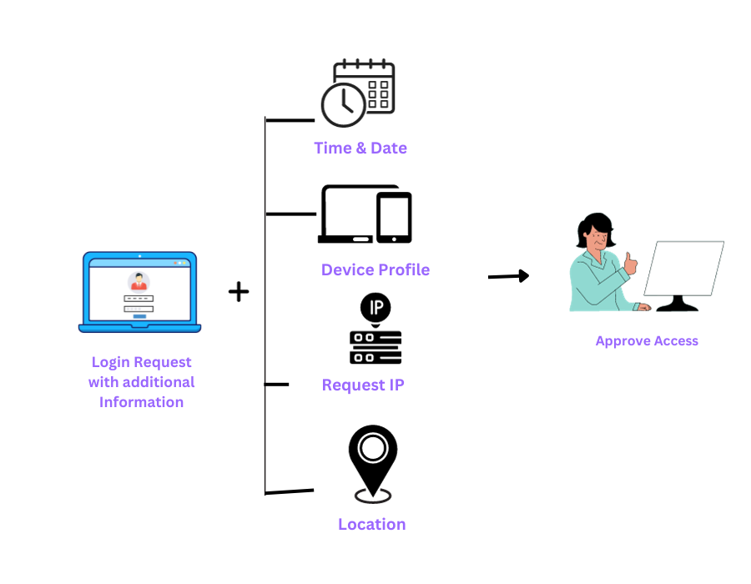
The Importance of Adaptive Multi-Factor Authentication (Adaptive MFA)
What is Adaptive MFA? Adaptive MFA adjusts authentication requirements based on
factors like user behavior, location, and risk level.
Benefits of Adaptive MFA:
Offers customized security, improving both protection and user experience.
Helps prevent breaches by responding dynamically to suspicious behavior.

Slide 5
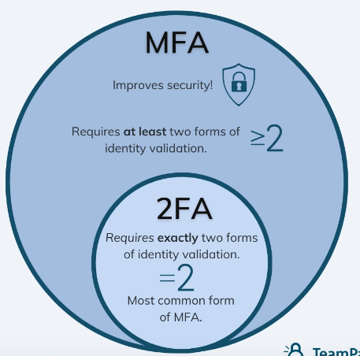
Objectives of the Presentation
Examine the Effectiveness of MFA Systems
Details: By evaluating different MFA techniques, we can understand which approaches offer the best protection against phishing, credential theft, and other forms of cyberattacks.
Analyze the Challenges in MFA Implementation
Details: Issues like balancing usability and security, infrastructure requirements, cost implications, and potential vulnerabilities such as MFA bypass or man-in-the-middle attacks will be explored.
Propose Solutions to Improve MFA Adoption
Details: Proposed solutions may include emphasizing adaptive MFA for greater flexibility, optimizing user experience, and cost-effective deployment options to improve adoption rates.

Slide 6
The Risks of Single-Factor Authentication
Increased Exposure to Cyber Threats: Relying solely on passwords leaves organizations vulnerable to various cyberattacks.
Susceptibility to Attack Methods: Passwords can be easily guessed, stolen, or compromised through brute-force attacks.
Unrestricted Access upon Compromise: A breached password can grant attackers full access to sensitive systems and data.
Weak or Recycled Passwords: Commonly used weak or repeated passwords worsen security risks, making unauthorized access
easier for cybercriminals.
High-Profile Data Breaches as Warnings:
2017 Equifax Breach: Exposed 148 million individuals' personal data due to a compromised password.
2014 Yahoo Breach: Over 3 billion user accounts were affected by stolen credentials, highlighting the
risks of single-factor reliance.

Slide 7
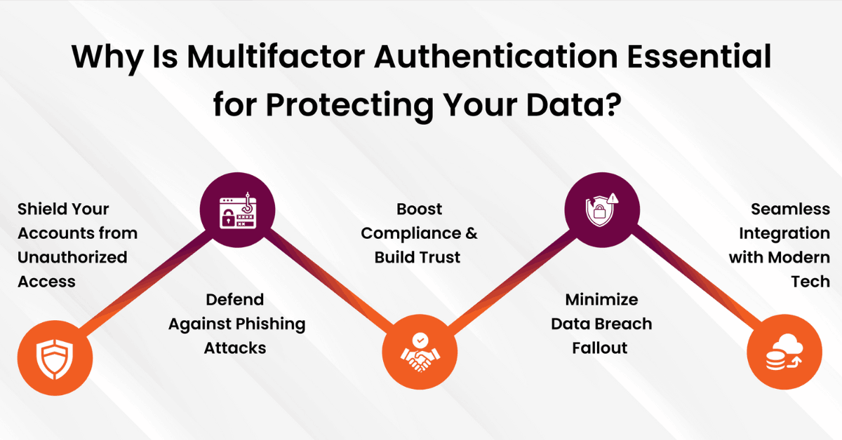
Is MFA really essential???

Slide 8
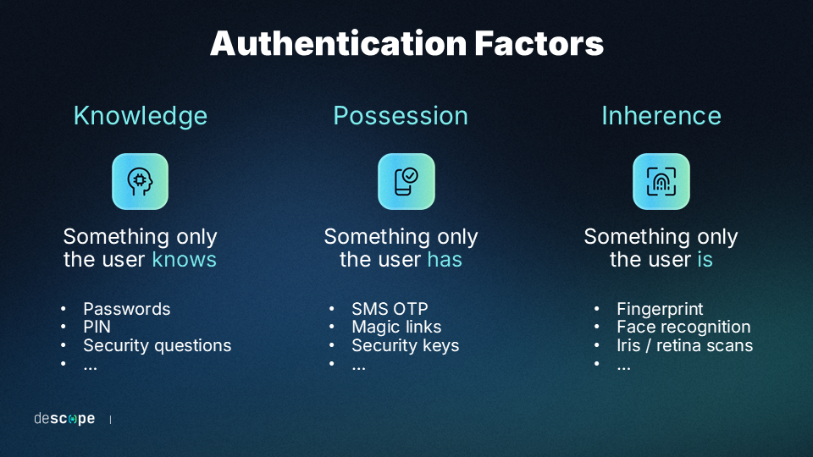
Current MFA Techniques
Knowledge-Based Factors
Example: Passwords, PINs
Description: Something the user knows, but can be vulnerable if compromised.
Possession-Based Factors
Example: One-Time Passwords (OTPs), Hardware Tokens
Description: Something the user has, such as a phone or physical token.
Inherence-Based Factors
Example: Biometrics (fingerprint, facial recognition)
Description: Something unique to the user’s physical traits.

Slide 9
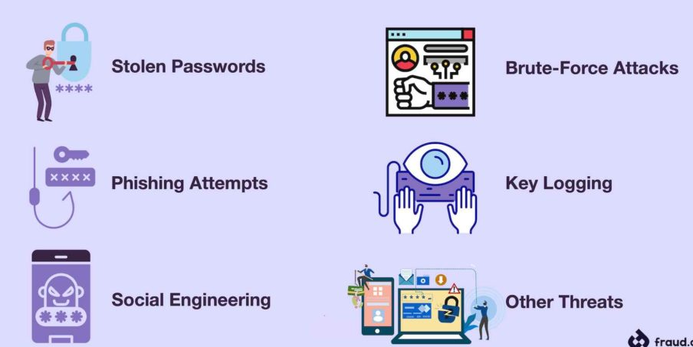
MFA Effectiveness in Preventing Cyberattacks
Defense Against Phishing: MFA prevents unauthorized access even if credentials are compromised in a phishing attempt.
Protection from Credential Theft: Ensures that stolen passwords alone are not enough to gain access, reducing successful breaches.
Enhanced Security Layer: Reduces the risk of attacks like brute force by adding additional verification steps.

Slide 10
Challenges in MFA Implementation
Usability vs. Security Balance
Finding a balance between secure MFA protocols and ease of use for end-users.
Infrastructure Requirements
Organizations often need updated systems and technologies to implement MFA effectively.
Costs and Complexity
Deployment of MFA can be expensive and technically challenging, especially in larger organizations.
Vulnerabilities in MFA
Risks such as MFA bypass techniques, phishing, and man-in-the-middle attacks still pose a challenge.

Slide 11
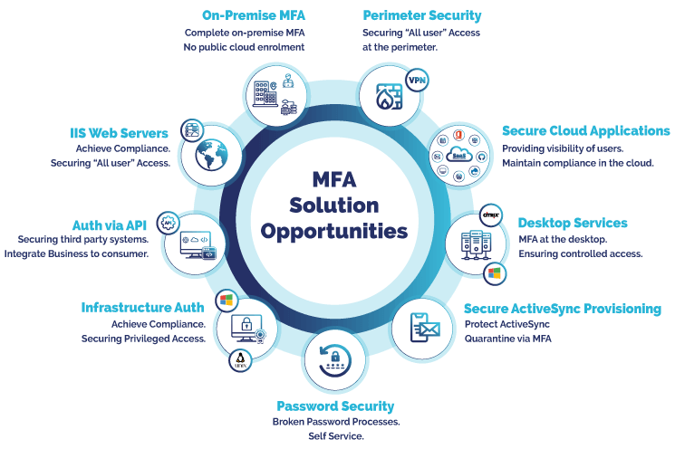
MFA solution opportunities:

Slide 12
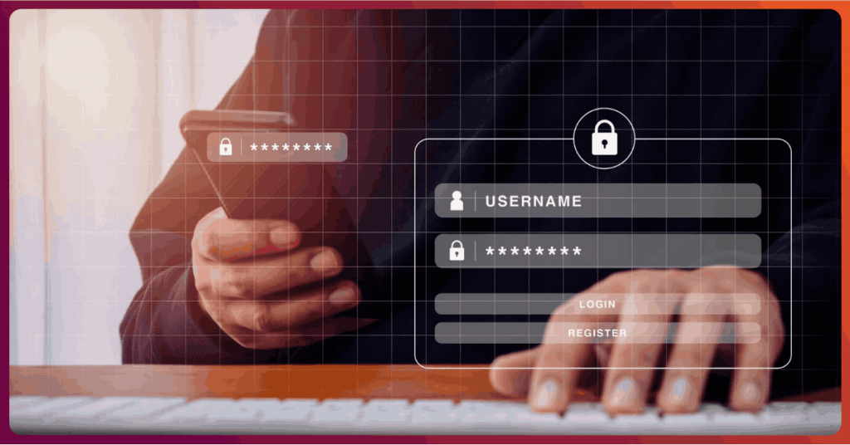
Summary & Conclusion
Summary of Key Points:
MFA is essential for cybersecurity as it strengthens access controls.
Adaptive MFA offers flexibility and better security.
There are significant challenges to implementation, including costs and potential vulnerabilities.
Final Thought:
As cyber threats grow, adopting and improving MFA is essential for a safer digital future.

Slide 13


